Slide 1

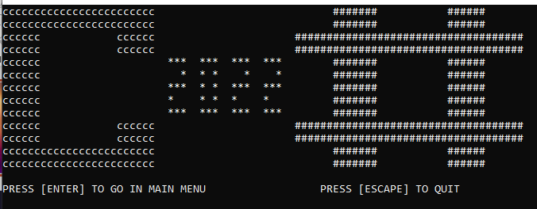
Pacman C # 2022
Miguel Jerome
Synn Sloan Igondjo

Slide 2



Evenement Du Jeu
Game Title
Game Menu
Game Level
Game Restart or Quit
Game Credit

Slide 3
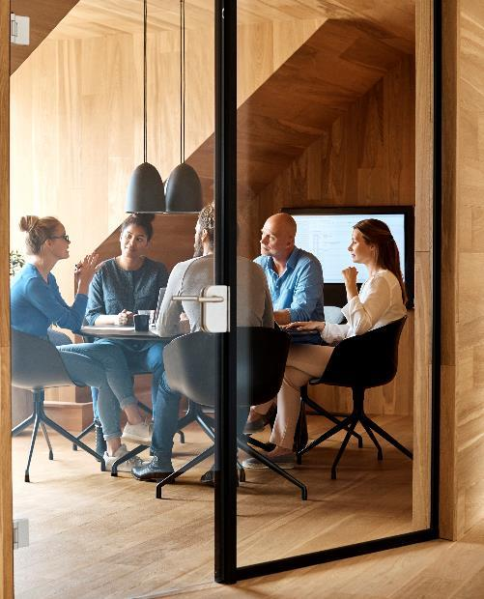



Game Title

Slide 4

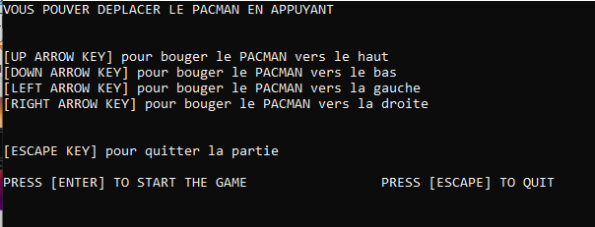
Game Menu
Les touches pour le jeu

Slide 5
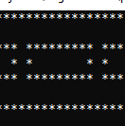
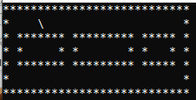
Game Level
Pacman
Labyrinthe

Slide 6
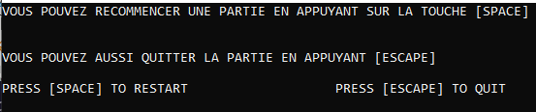
Game Restart or Quit
Player Game Options
Restart
Quit

Slide 7
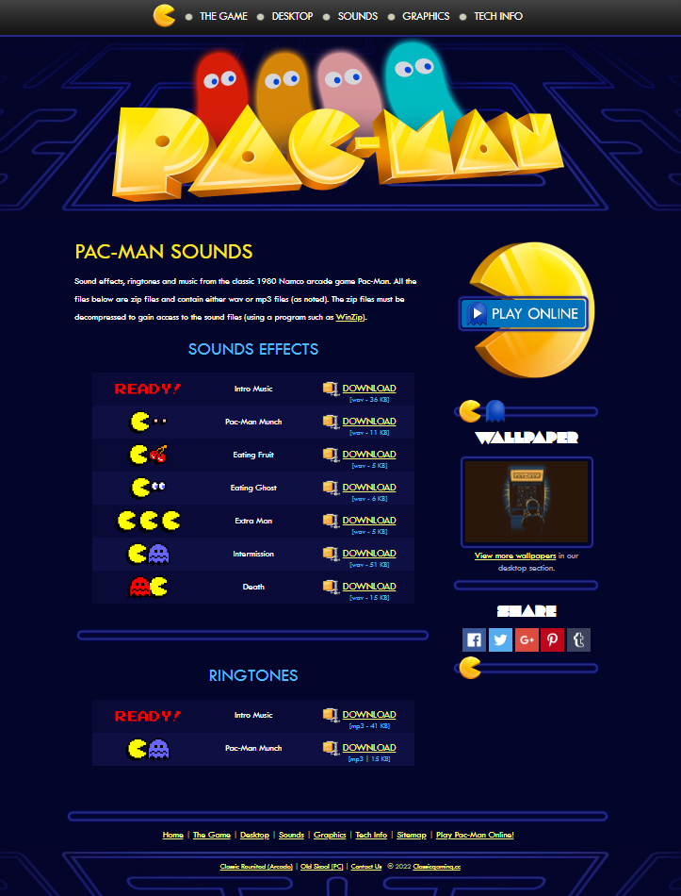
Game Sounds
Game sound effects
Classic gaming
sound Intermission
sound pacman-beginning
sound pacman-chomp
sound pacman-death
sound pacman-eatfruit
sound pacman-eatghost
sound pacman-intermission

Slide 8


Merci
Miguel Jerome
Synn Sloan Igondjo
https://github.com/MiguelJerome/projectc-

